Slide 2
Replay Attacks
Retransmission of data

Slide 3

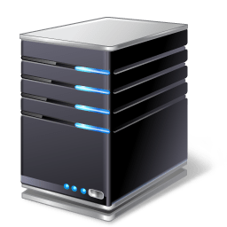

Replay Attacks
User
Logon Server
User logs in
Login successful
Resource Server
Access resource

Slide 4

Replay Attacks
User
Logon Server
User logs in
Login successful
Access resource
Resource Server
Capture logon

Slide 5
Replay Attacks
Login Server
Resource Server
Retransmits resource request
Attacker

Slide 6

Replay attacks
Login Server
Resource Server
Retransmits resource request
Attacker
Notes:
Show TLS traffic with Application data ( encrypted)
Show TLS traffic with sequencing and timestamping

Slide 7
Pash the Hash
Login Server
Logon (1359udefrudei8)
Attacker
Collect hash value

Slide 8
Pash the Hash
Attacker
Login Server
Retransmits password hash

